Slide 1
GAN-BERT: Generative Adversarial Learning for Robust Text Classification with a Bunch of Labeled Examples [1] Danilo Croce, Dept. of Enterprise Engineering University of Rome, Tor Vergata Roma, Italy
Giuseppe Castellucci, Amazon, Seattle, USA
Roberto Basili, Dept. of Enterprise Engineering University of Rome, Tor Vergata Roma, Italy
Paper Review By:
Md. Tanvir Rouf Shawon
ID: 21366009 Group No: 08
Raihan Tanvir
ID: 21366011

Slide 2
Why GAN-Bert Is Special?
Semi-supervised GAN in NLP
Fine tune BERT with unlabeled data
Little labeled data required to get good performance

Slide 3
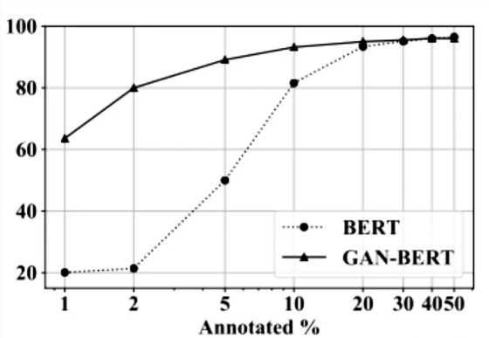
High Performance Under Low Resource Setting

Slide 4
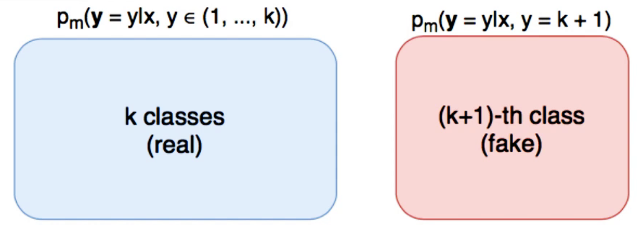
Semi-supervised GAN [2][3]

Slide 5
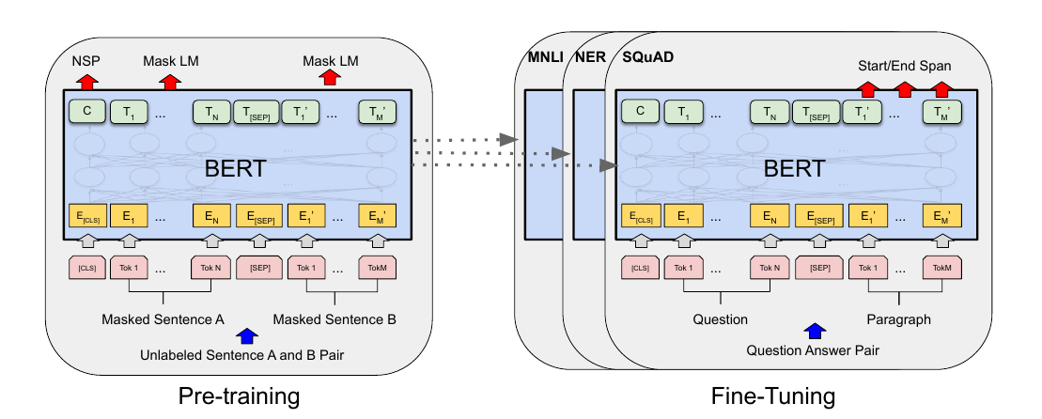
Bert Architecture [4]

Slide 6
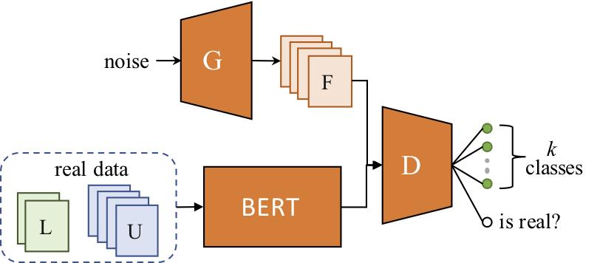
GAN-Bert Architecture

Slide 7
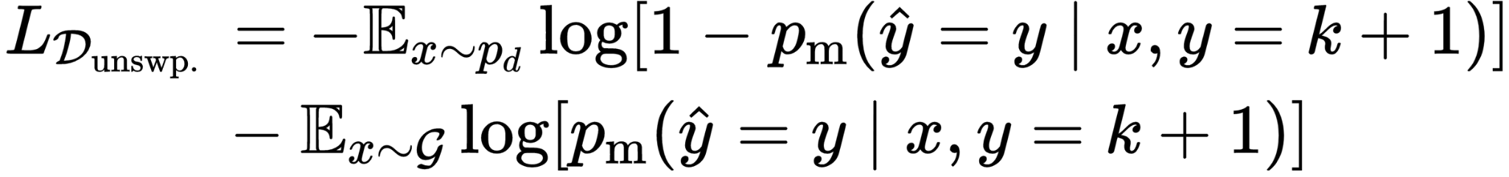

Discriminator Loss Function

Slide 8
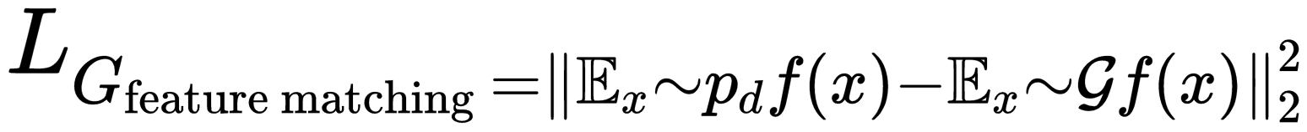
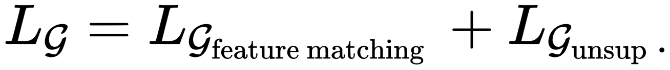
Generator Loss Function

Slide 9
Datasets
Task | Dataset | Performance Metric
Topic Classification | 20 News Group (20N) | F1
Question Classification | UIUC | Accuracy
Sentiment Analysis | SST-5 | Accuracy
Sentence Pairing | MNLI | F1

Slide 10
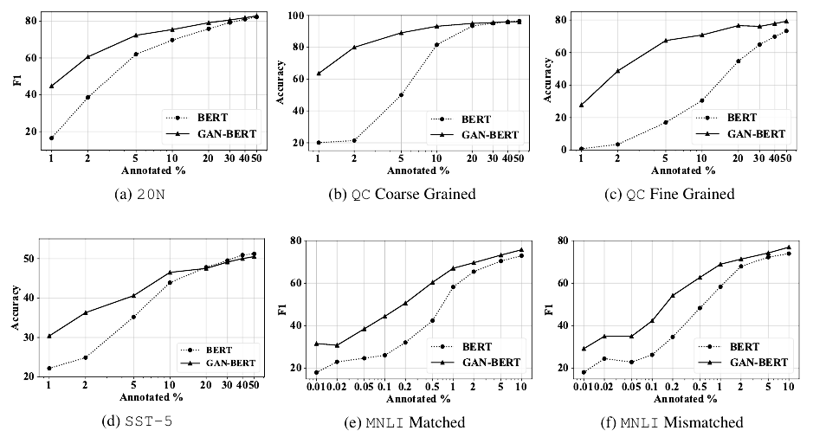
Efficiency of GAN-Bert

Slide 11
Conclusion
Extended the capability of BERT
More data efficient
No additional cost during inference

Slide 12
References
Croce, Danilo, Giuseppe Castellucci, and Roberto Basili. "GAN-BERT: Generative adversarial learning for robust text classification with a bunch of labeled examples." In Proceedings of the 58th Annual Meeting of the Association for Computational Linguistics, pp. 2114-2119. 2020.
Goodfellow, Ian, Jean Pouget-Abadie, Mehdi Mirza, Bing Xu, David Warde-Farley, Sherjil Ozair, Aaron Courville, and Yoshua Bengio. "Generative adversarial networks." Communications of the ACM 63, no. 11 (2020): 139-144.
Salimans, Tim, Ian Goodfellow, Wojciech Zaremba, Vicki Cheung, Alec Radford, and Xi Chen. "Improved techniques for training gans." Advances in neural information processing systems 29 (2016): 2234-2242.
Devlin, Jacob, Ming-Wei Chang, Kenton Lee, and Kristina Toutanova. "Bert: Pre-training of deep bidirectional transformers for language understanding." arXiv preprint arXiv:1810.04805 (2018).

